Slide 1
ONLINE ELECTION VOTING
Guide By :
SUBMITED BY:
Er. Namita das (h.o.d of cse)
Sunita Mahonta (1521299027)
Amarjyoti Raj (1401299023)
Bibekananda Bhuyan (1401299016)

Slide 2
INTRODUCTION :
Online Voting is an android based application.
It is an online voting technique.
In this system people who have citizenship of India and whose age is above 18 years of age and any sex can give his\her vote online without going to any physical polling station.
He\She has to be registered first for him/her to vote.
Registration is mainly done by the system administrator for security reasons.
After registration, the voter is assigned a secret Voter ID with which he/she can use to log into the system.
If invalid/wrong details are submitted, then the citizen is not registered to vote.

Slide 3
SYSTEM OVERVIEW:-
The user data, candidates data and voting process will be manage automated the traditional system.
No need to use Electronic Voting Machine (EVM).
Easy to check voting result.
Result will announced automatically within 1 sec after completing voting process.
User, candidates and admin will notify all the details about the voting time, date and etc.

Slide 4
Objectives:-
The specific objectives of the project include:
Reviewing the existing/current voting process or approach in India.
Coming up with an automated voting system in India.
Implementing an automated/online voting system.
Validating the system to ensure that only legible voters are allowed to vote.

Slide 5

HARDWARE AND SOFTWARE Requirement :-
The workstation android device should have at least following configuration :-
800 MHz Processor.
100 Mb Ram.
AIP level 22.
3 Mb Rom.
Operating system require Android version 4.0 or above.

Slide 6
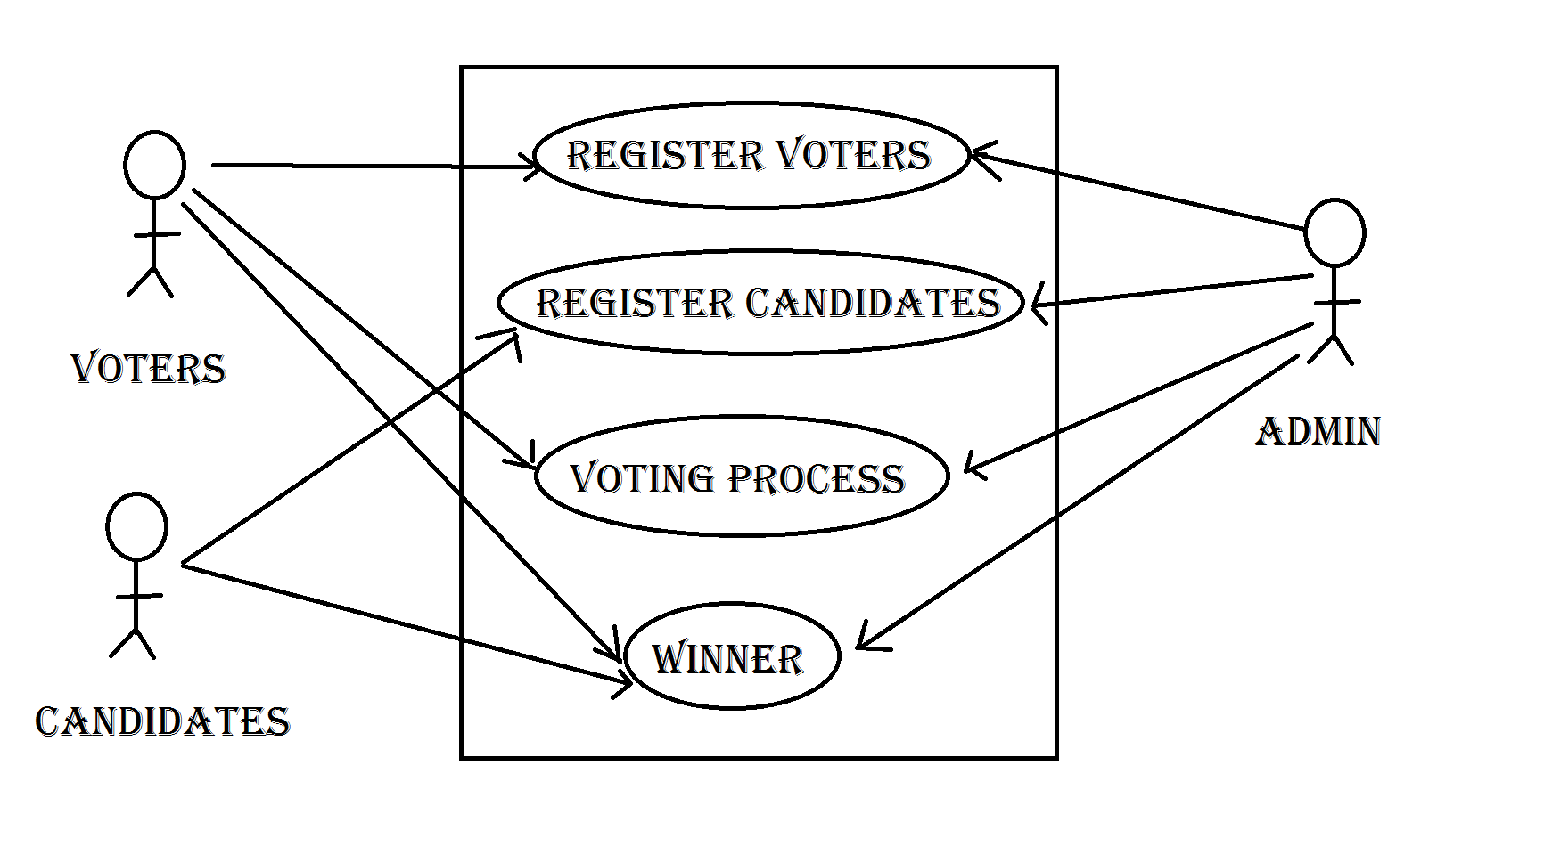
Use case diagram :-

Slide 7
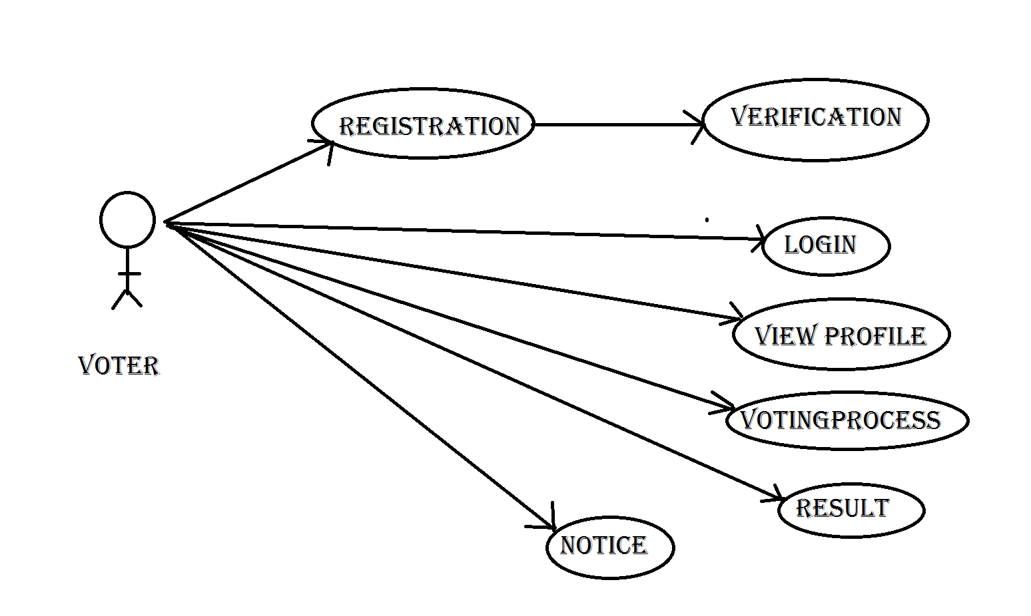
Voter Use case diagram :-

Slide 8
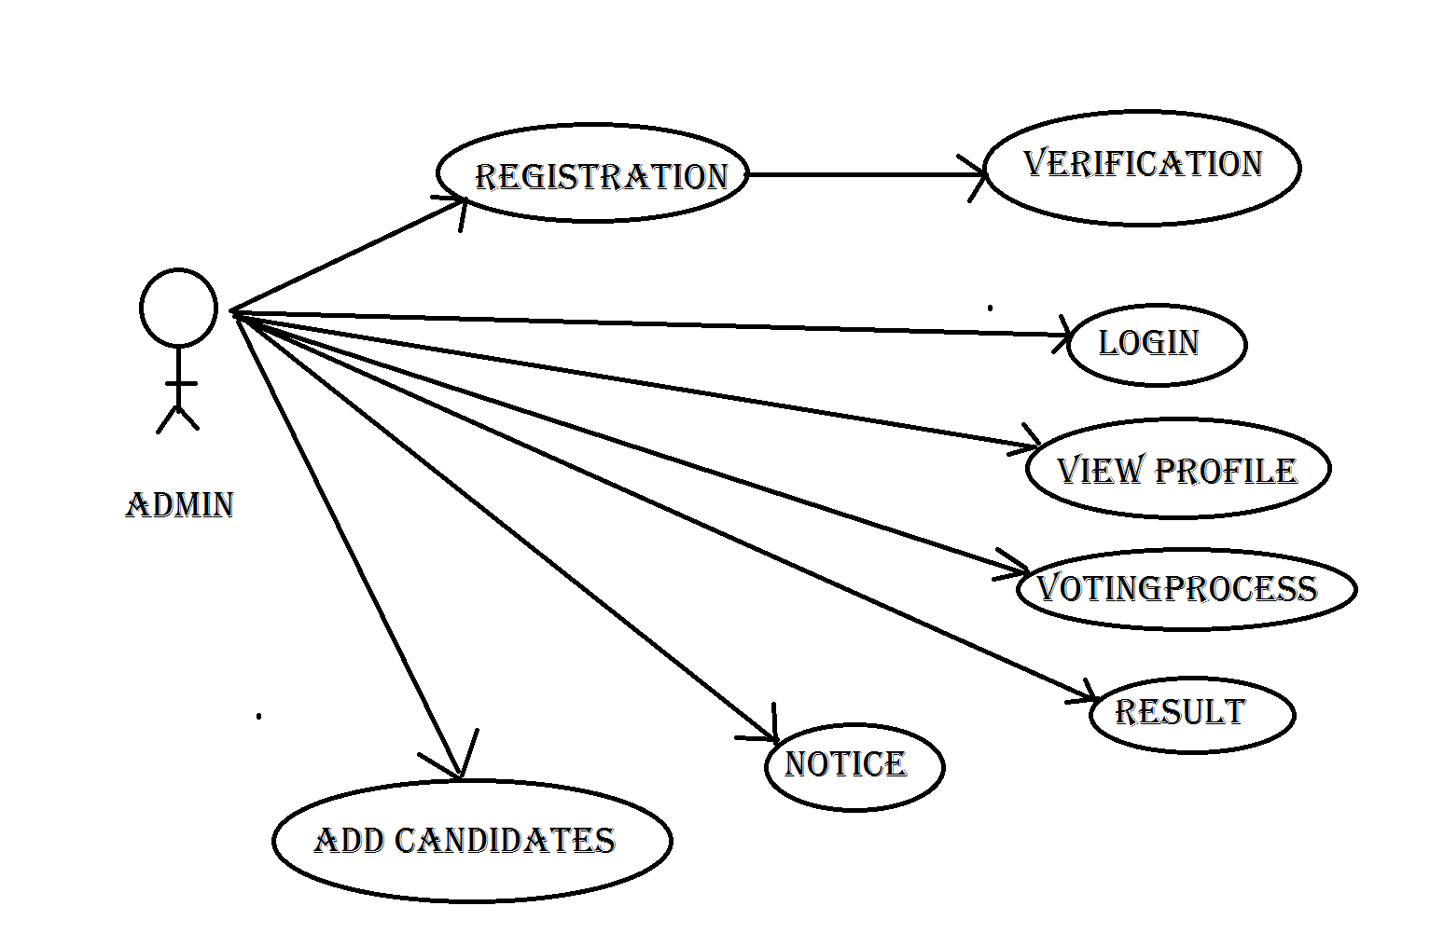
admin Use case diagram :-

Slide 9
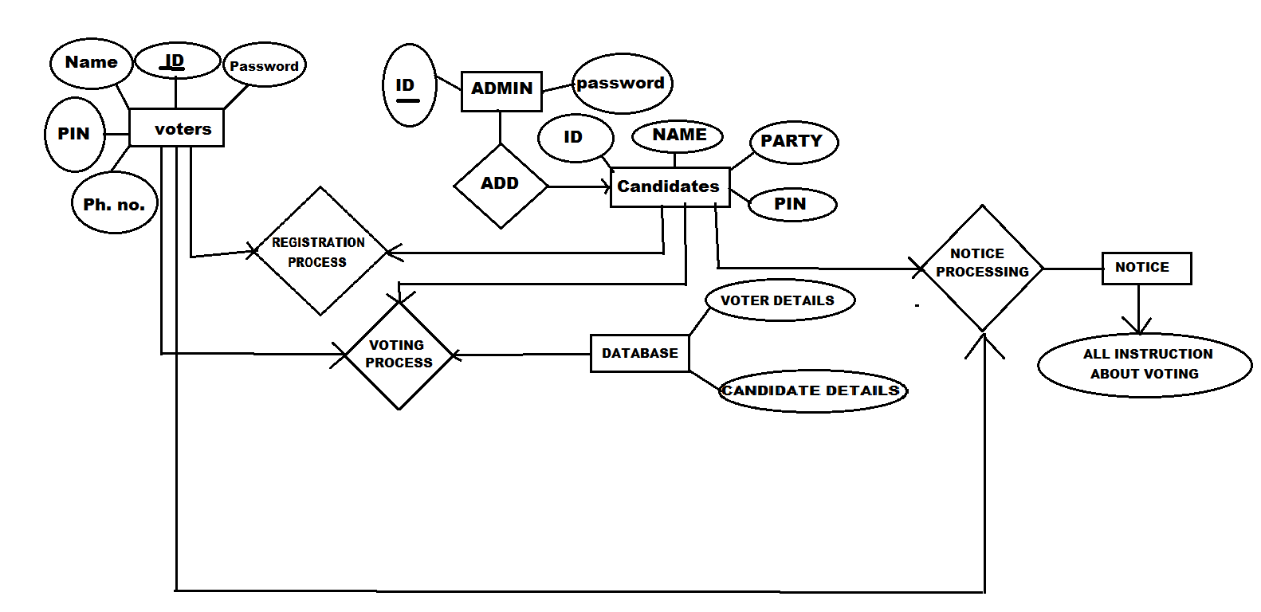
Er model :-

Slide 10
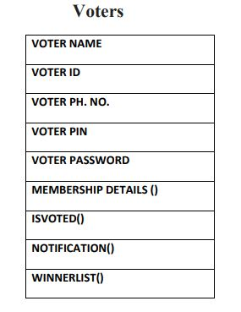
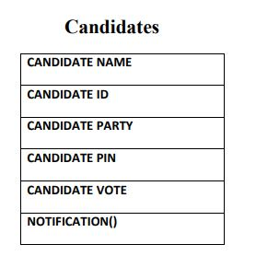
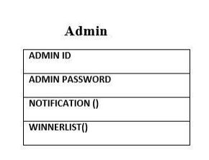
Class diagram :-

Slide 11
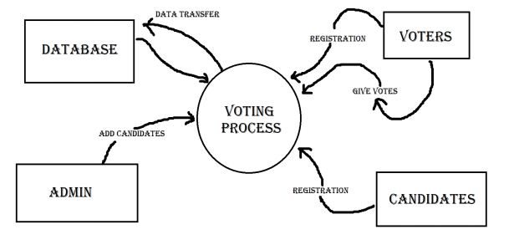
Data flow diagram :-
0th Level

Slide 12
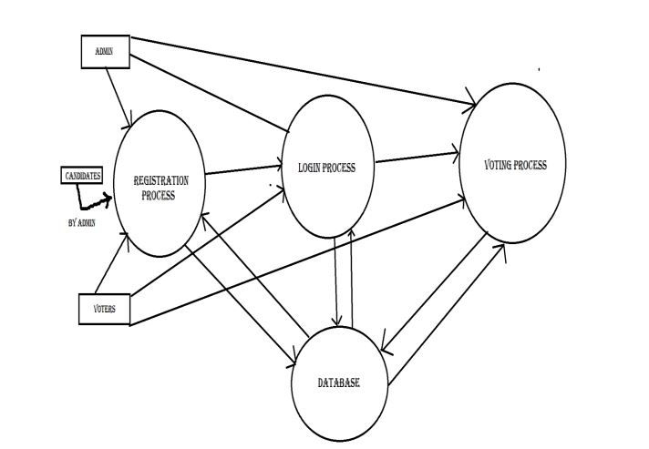
Data flow diagram :-
1st Level

Slide 13
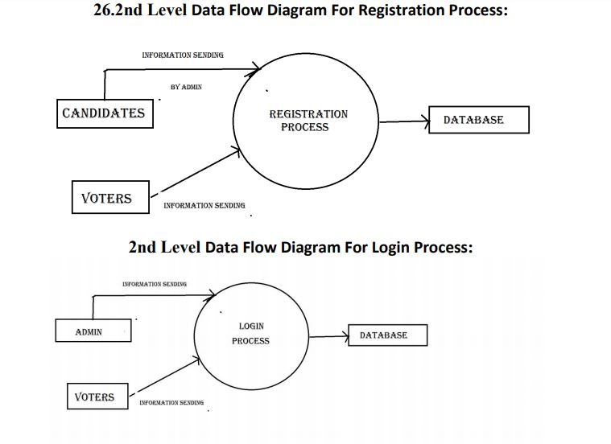

Slide 14
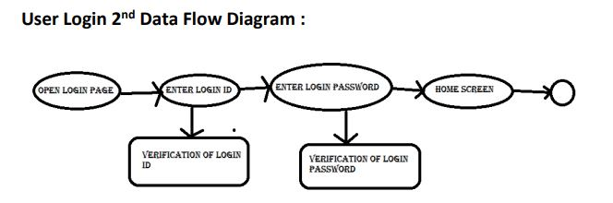
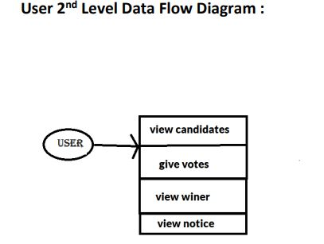

Slide 15
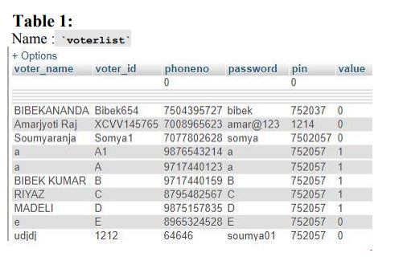
Data base design :-

Slide 16
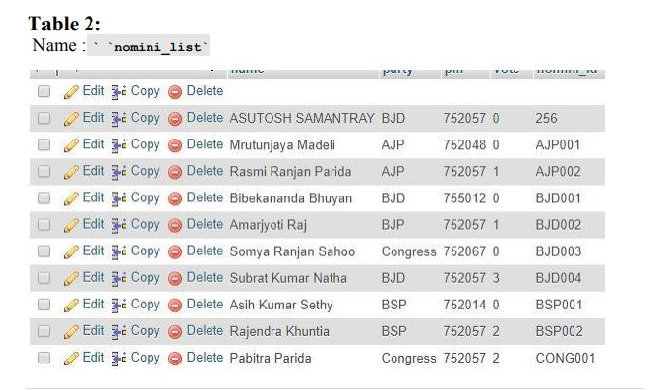

Slide 17
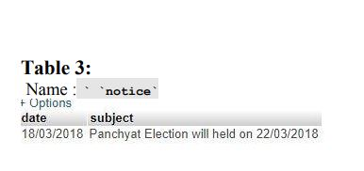

Slide 18
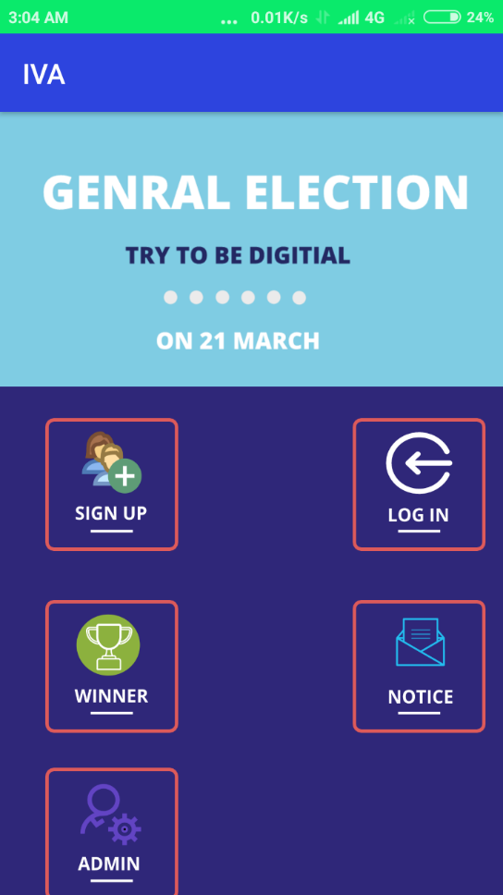
Screen shots
Home screen

Slide 19
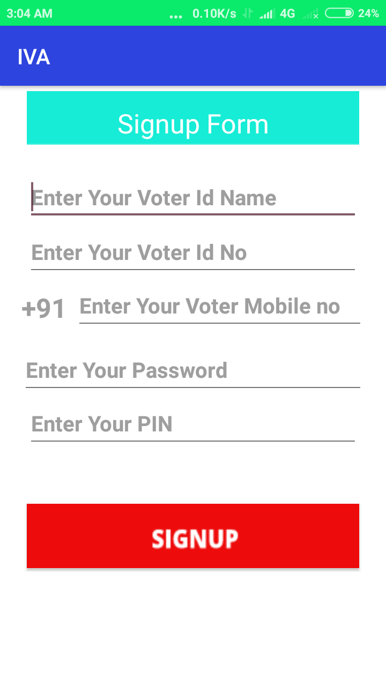
User signup

Slide 20
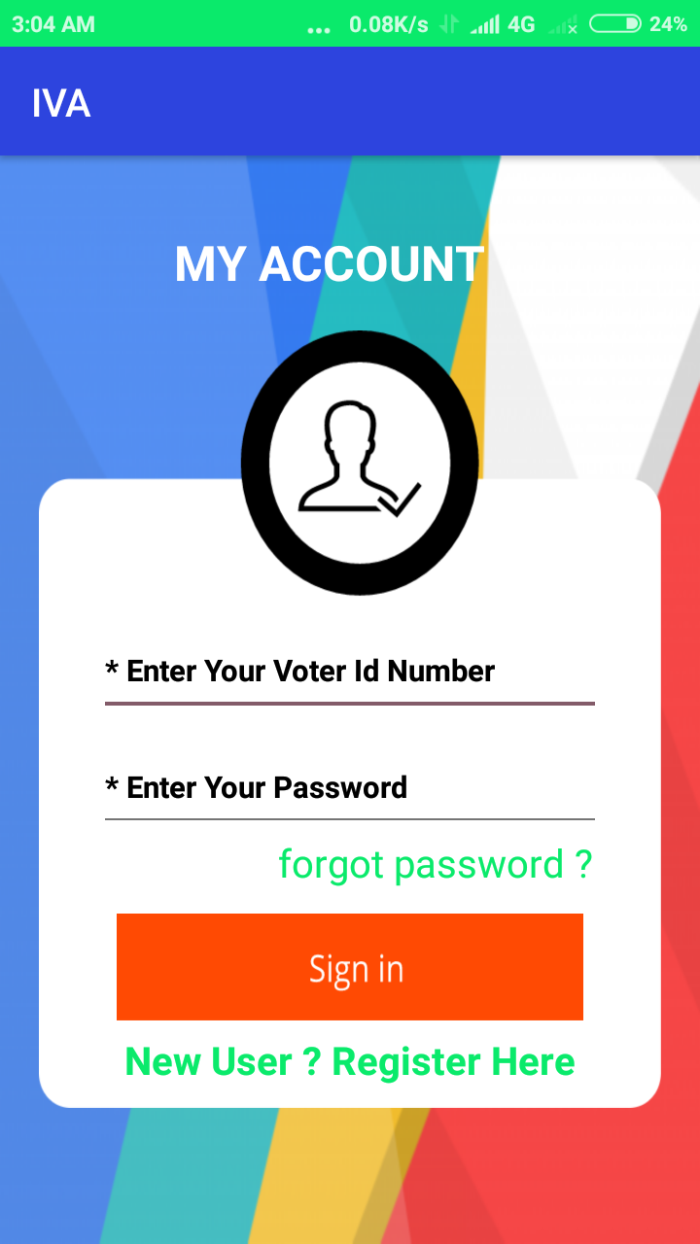
User LOGIN

Slide 21
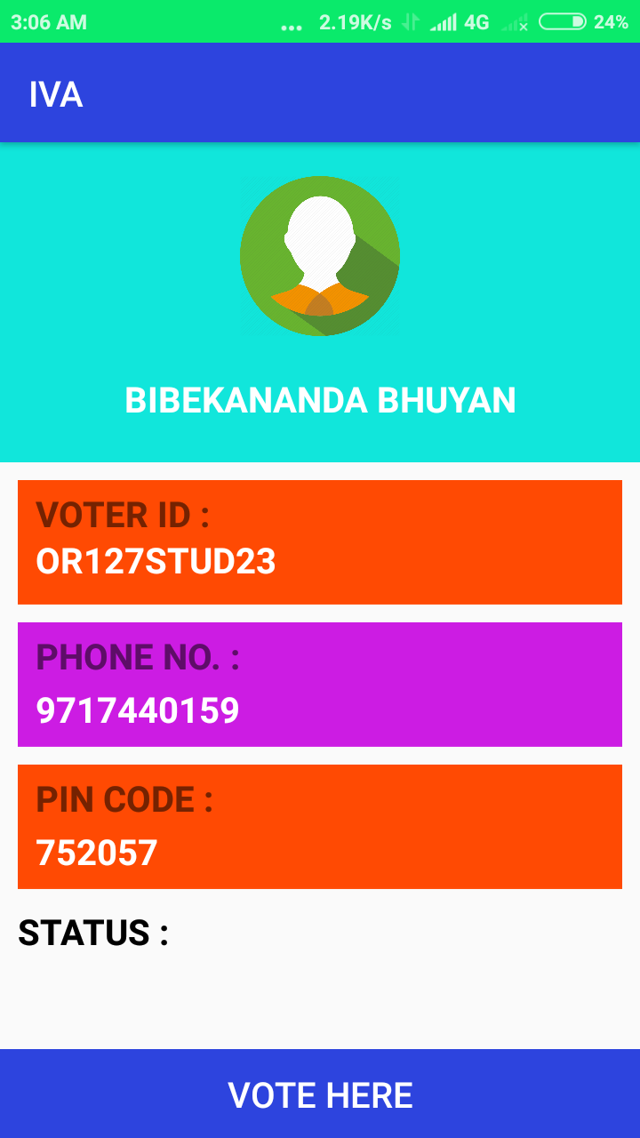
User profile

Slide 22
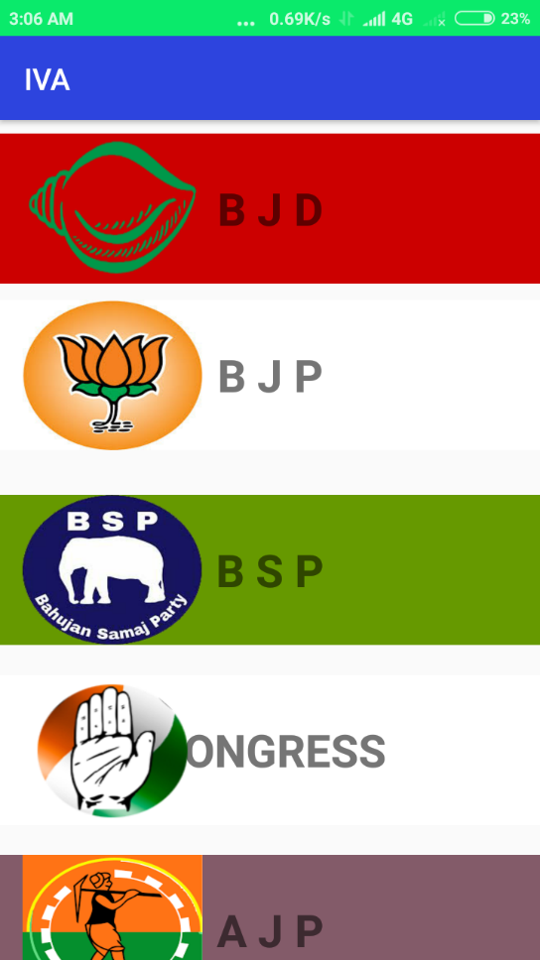
Party list

Slide 23
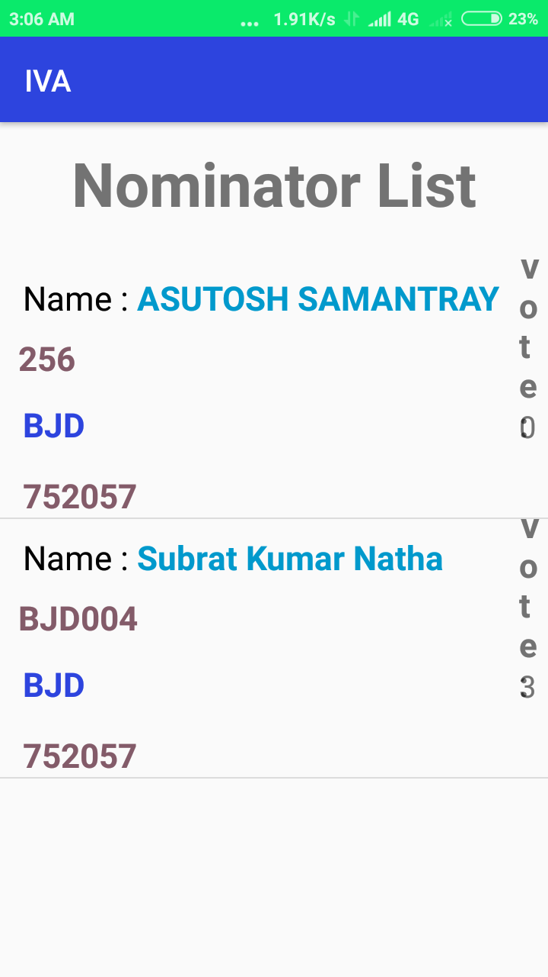
Nominator list

Slide 24
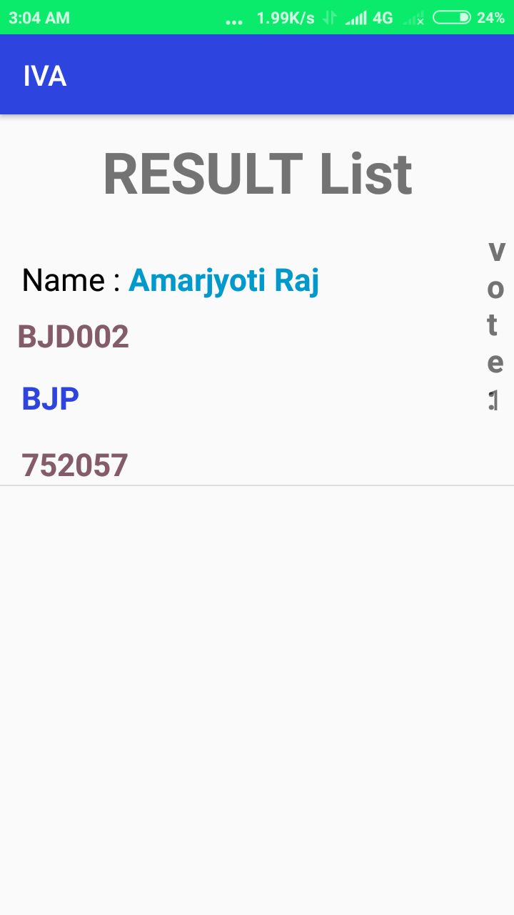
Result list

Slide 25
CONCLUSION :-
This Online Voting system will manage the Voter’s information by which voter can login and use his voting rights.
It provides the tools for maintaining voter’s vote to every party and it count total no. of votes of every party.
There is a DATABASE which is maintained by the ELECTION COMMISION OF INDIA in which all the names of voter with complete information is stored.
By online voting system percentage of voting is increases.

Slide 26


